Slide 1


ENERGY EFFICIENCY PROGRAM
Protecting and Preserving the water and wastewater resources of rural Illinois through education, representation and on-site technical assistance.
David speagle
Energy efficiency technician

Slide 2

IRWA Energy Efficiency Program
Pilot Program – began in July 1,2014
Funded by Rural development thru NRWA
Recently expanded to 34 states
Must complete 30 assessments per year
NO COST TO THE SYSTEM FOR THE ASSESSMENT
NOT REQUIRED TO COMPLY WITH RECOMMENDATIONS

Slide 3
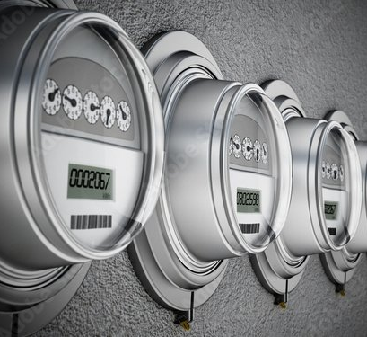
ENERGY EFFICIENCY
Energy efficiency is the use of less energy to perform the same task or produce the same result. Energy-efficient buildings use less energy to heat, cool, and run appliances and electronics, and energy-efficient facilities use less energy to produce THEIR PRODUCT.

Slide 4

RATES & STRUCTURES

Slide 5
June 1, 2022 Electricity Price Spike in Central and Southern Illinois
What happened on June 1?
On June 1, the price for electricity more than doubled for Ameren customers across Central and Southern Illinois, costing customers hundreds of dollars in higher power bills over the next year.
How much does this price spike cost me?
Ameren’s summer “price to compare”–the supply rate you compare with alternative supplier offers–rose to 10.628 cents per kilowatt-hour (kWh). That’s a 120 percent increase over last June’s supply rate. Ameren says: “The typical Ameren Illinois residential customer will see a $626 annual increase on the power supply side of the bill, or an average of $52 or more per month throughout the year.” The increase could be even more for electric heat customers.
How long will prices stay elevated?

Slide 6
ILLINOIS UTILITIES LAUNCH UNPRECEDENTED CAMPAIGN TO RAISE RATES BY A COMBINED TOTAL OF $2.8 BILLION!
JANUARY 2023 – C.U.B.

Slide 7
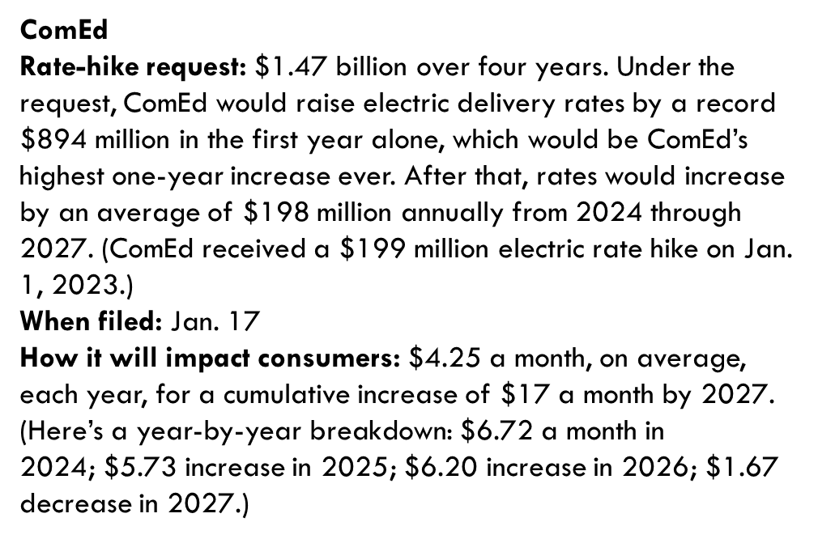

Slide 8
Ameren Illinois (electric)
Rate-hike request: $435.6 million over four years.
When filed: Jan. 20
How it will impact consumers: Unknown
Ameren Illinois (gas)
Rate-hike request: $160.4 million. (Ameren received a $76 million rate hike in January 2021.)
When filed: Jan. 6
How it will impact consumers: In a public notice, Ameren said a residential customer using about 745 therms a year, or about 62 therms monthly, would pay an extra $6.68 a month.

Slide 9
Why is this price spike happening?
This is related to several factors, many of which have impacted energy markets across the world.
Natural gas prices have been at extremely high levels for more than a year because of multiple factors, including, most recently, the Russian invasion of Ukraine. The high gas prices have now led to high electricity prices–because natural gas is often used to generate power. UPDATE: The Energy Department predicts Midwest gas customers could pay about 33% more to stay warm this winter. And some Illinois predictions are as high as 59%. Citizen's utility board announcement 10/25/2022.
Adding to the high energy price is a recent electric “capacity” auction held by the Midcontinent Independent System Operator (MISO), the power grid operator for all or parts of 14 states, including Central and Southern Illinois. Capacity costs, which are wrapped into the price we pay for electricity, are payments we make to power plant operators to have adequate reserve electricity. The capacity cost is determined by a yearly auction, and in the most recent auction, in April 2022, the price rose from $5/MegaWatt (MW)-day to $236.66/MW-day in several Midwestern states, including Illinois (part of MISO’s Zone 4). The increase was “driven by an uptick in projected electricity use and a dip in power supply,” Utility Dive reported.

Slide 10
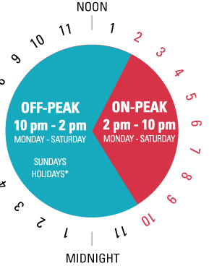
Hours – Peak vs non-peak
Some electric suppliers may offer interruptible rates
  During high demand periods you may be requested to shutdown your water/wastewater facility
  The request will contain a range of hours for shutdown
  Standby generation would be necessary
Some electric suppliers have peak and non-peak rates
Real Time Pricing or Hourly Supply Service
If so, determine if your treatment process can run during non-peak hours

Slide 11
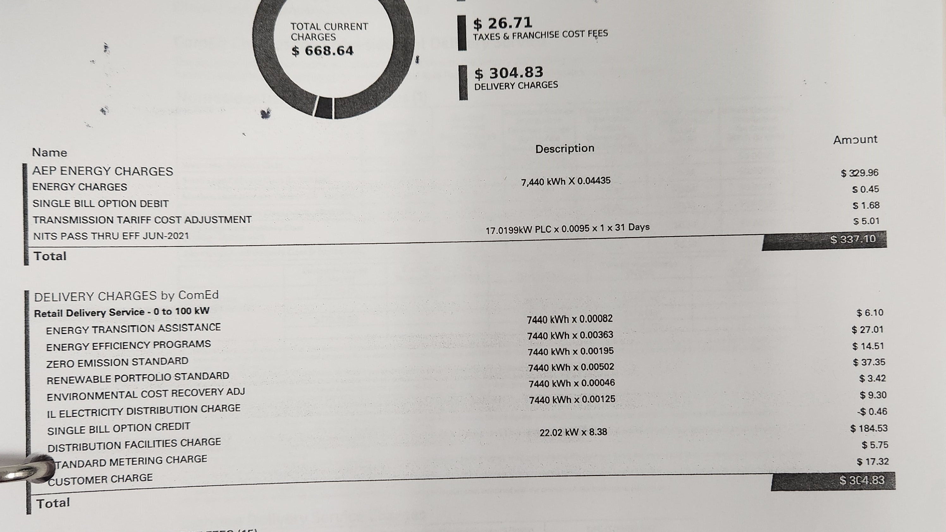

Slide 12
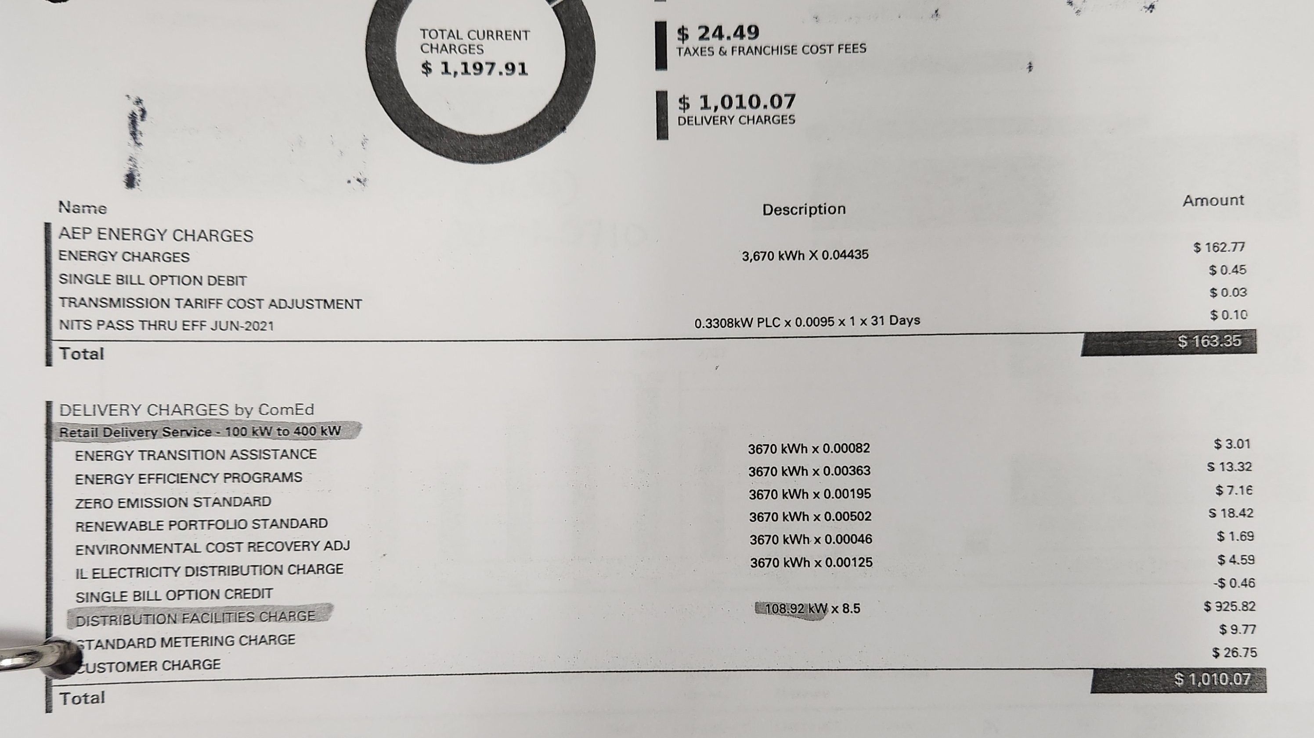

Slide 13
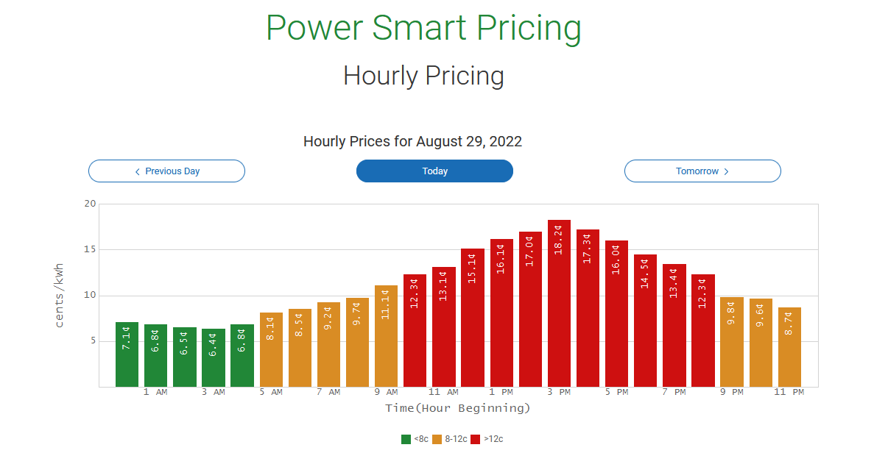

Slide 14
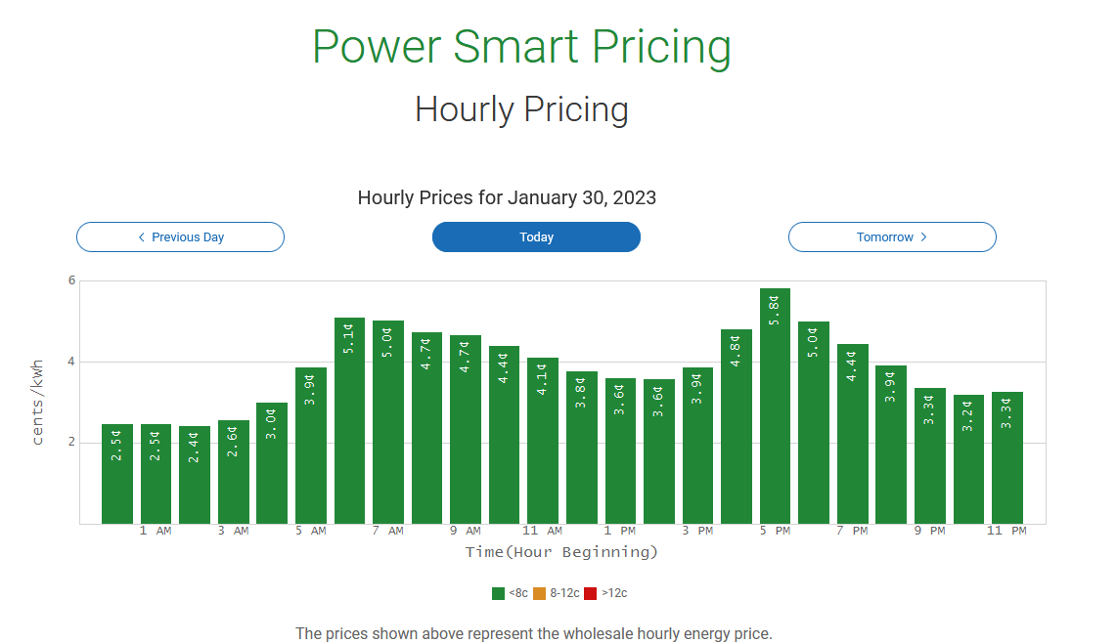

Slide 15
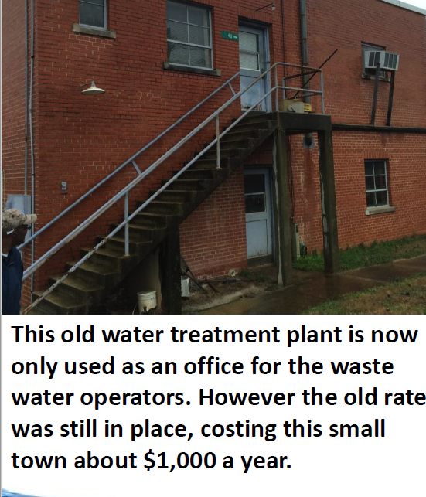

Slide 16
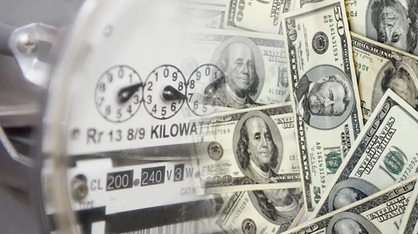
WHAT DOES AN ASSESSMENT CONSIST OF?

Slide 17
Identify potential cost savings
Evaluate items throughout the facilities
Photo documentation of equipment
Thermal imaging FLIR
Electrical Information
Incentives from Electric Supplier
Provide Recommendations

Slide 18
What do you provide?
At least one copy of your utility bill for each facility/location, a year is preferred.
An hour or two (depending on the size of the facility and the number of locations, lift stations, pumping stations etc.) for someone to escort me around to gather data points and photographs of name plates.
Knowledge of what the electrical conditions are at certain pieces of equipment, such as voltage, phase conditions and run times.
Explanation of your process, particularly high energy consuming items.

Slide 19
Potential cost savings
Premium efficiency motors
Variable frequency drives (VFD)
Off-peak hours/peak hours
Demand charges
Evaluate treatment processes for efficiency
Climate Control/ HVAC
Lighting
Building

Slide 20
How we use energy in our plants
EPA estimates 2% of power generated in the us is for water and wastewater treatment (56 billion kwh, $4 billion, 45 tons of greenhouse gas produced)
Electrical energy – used to conduct unit processes and operations
Aeration and pumping in wastewater treatment
Pumping for drinking water treatment
30% to 40% of total operational costs are energy

Slide 21
Motors typically make up 90% of the potable water load (pumping) and 70% or more of wastewater system (aeration and pumping). They are the single most important thing to look at regarding energy usage in these systems.

Slide 22
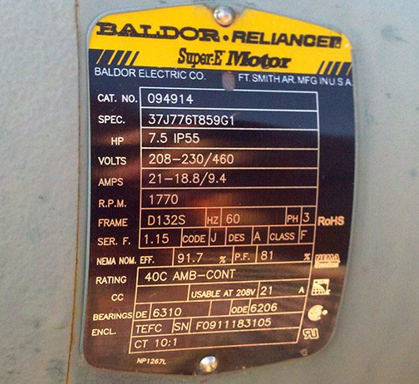
Premium efficiency motors
Average efficiency of an electric motor is 85%
Any motor with an efficiency rating above 90% is considered to be a premium efficiency motor
Efficiency ratings can get to be as high as 98%
Compare current motors to premium efficient replacement motors

Slide 23
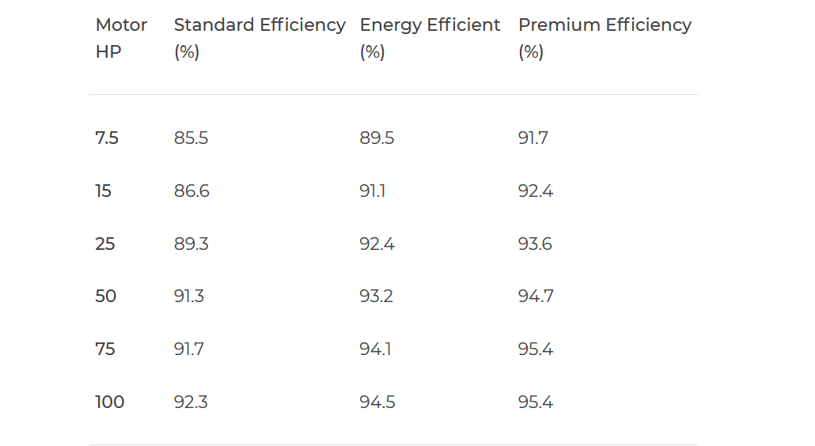

Slide 25
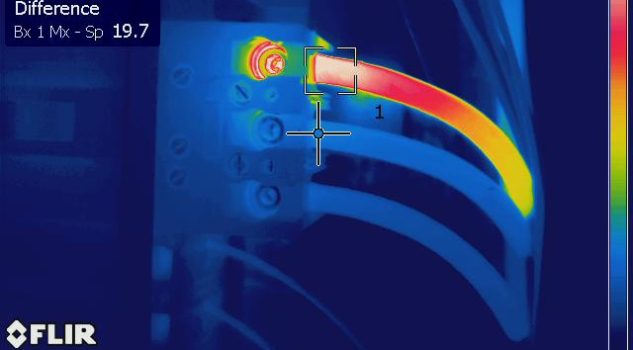

Slide 27
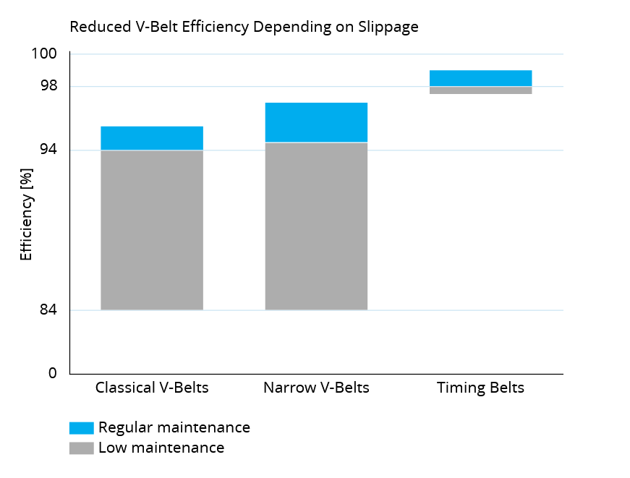

Slide 28
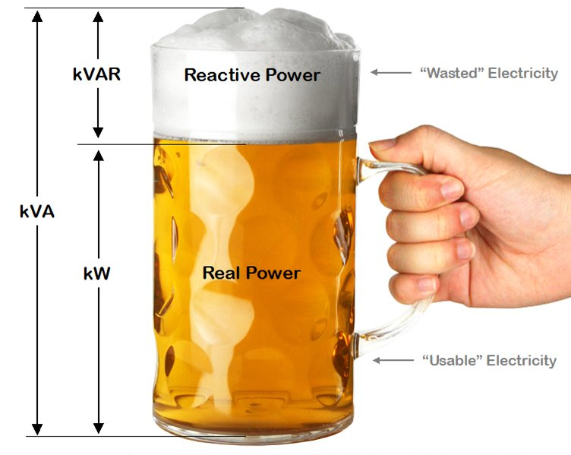

Slide 29
Possible VFD Opportunities
Valve throttled?
`
Aerator valve throttled?6

Slide 30
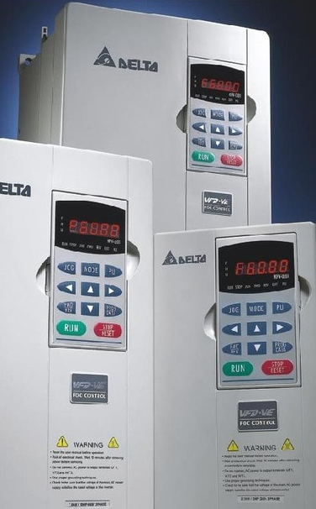
Variable frequency drives
Generally Recommended for motors greater than 5 hp
Cost savings are based on:
Number of start/stop cycles per day
Amount the flow is throttled
Motor life
Easier on infrastructure (Reduces water hammer)
Power company incentives (Vary according to supplier, but most have them.)

Slide 31
VFD BENEFITS
Energy Savings. VFDs save energy by enabling electric motors to operate at less than full speed. The Laws of Affinity for centrifugal pumps and fans states. Reducing motor speed by 25% decreases energy consumption by nearly 60% while reducing motor speed by 50% decreases energy consumption by nearly 90%. Even with the 2% to 3% energy loss in the VFD, the energy savings can be very significant.
Process Control. Reducing flow can allow for longer runs and less starts and stops on the process.
Reducing Wear. VFDs start motors slowly by ramping up the voltage rather than slamming motors with full line voltage to start. This reduces wear and potential overheating as well as water hammer.

Slide 32
VFD BENEFITS
Financial Incentives. Significant credits, rebates and tax deductions are available from many local utilities and governments agencies to incentivize the installation of energy-saving VFDs.
Reduce Demand Charges. Many commercial and industrial facilities are subject to utility Demand Changes based on the highest current demand occurring during a year. VFDs can help reduce Demand Charges by limiting motor inrush currents that can be 5 to 11 times higher than full-load current.
Offset Oversizing. In many HVAC applications, centrifugal fans and pumps are oversized to account for various uncertainties. VSD speed control minimizes energy wasted by oversized motors that may never run at full speed.

Slide 33
“Constant Torque” vs “Variable Torque” applications require different drives or at least apply drives differently
  https://www.pesquality.com/blog/constant-torque-drives-vs-variable-torque-drives
  Centrifugal fans and pumps are variable torque
  Positive displacement blowers and pumps are constant torque
U/F ratio or V/F ratio
  If the VFD has a setting for it, a “squared” U/F ratio can save energy
  This is the ratio of output voltage to frequency
  See pg 149 here: https://library.e.abb.com/public/6f400c8a653d4d57ae1df8dfed6d7e9f/EN_ACQ580_pump_control_program_FW_F_A5.pdf
Energy optimization settings on the drive
  Some drives have settings to optimize for energy savings
VFD’s can create damaging electrical noise both on the supply and output side of the drive
  Supply filtering is recommended when a significant percentage of the load at the facility is form VFD’s, especially if there are other sensitive electronics on the circuit
  Output filtering is required when the motor leads are too long, or the motor might not handle being on VFD correctly
Power factor correction
  If a facility has a lot of pumps, they can benefit from putting in power factor correction at their service entrance.
  This eliminates “imaginary” energy consumption, where the facility is billed for current draw that does not actually do any real “work”
  https://www.eaton.com/ecm/groups/public/@pub/@electrical/documents/content/sa02607001e.pdf

Slide 34
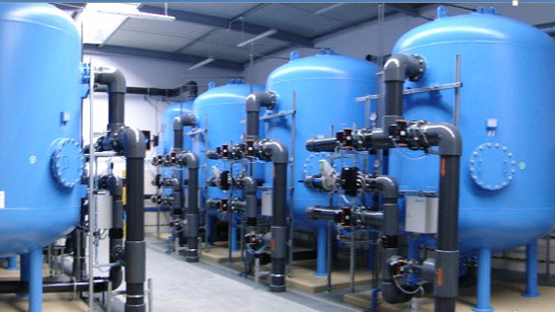
Treatment efficiency
Evaluate your systems operations
Are your backwash times and rates set at the proper levels
  Backwashes based on head loss or “That’s the way we’ve always done it”
  Backwash rate set at proper level
  Backwash duration set at proper increments
Simple things such as these can save a system a considerable amount of Money over a year’s time

Slide 35

Climate control/hvac
Efficiency of ac condenser (SEER – Seasonal energy efficiency ratio)
Efficiency of furnace – (AFUE % - Annualized Fuel utilization Efficiency
Programable thermostats/ Smart thermostats
Air filter maintenance schedule
Annual cleaning of Condenser
Notes:
Current SEER 10 As of 2015 the standard was changed to SEER 14

Slide 36
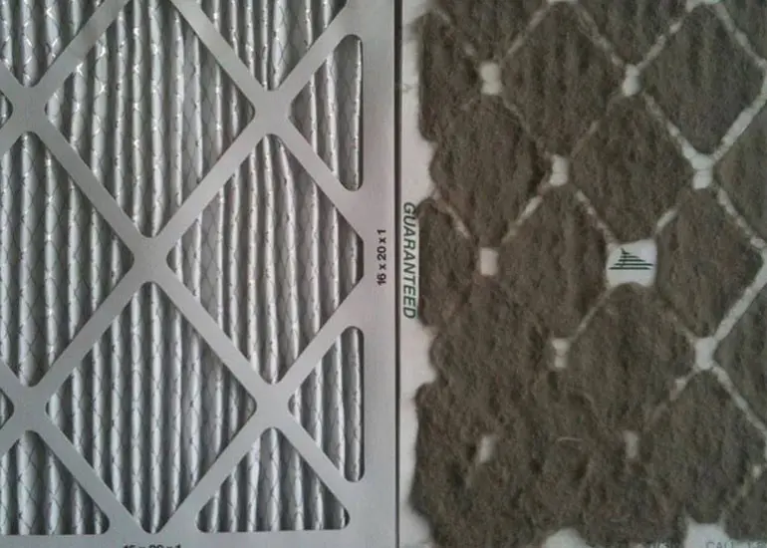
CHANGE YOUR FILTERS!!!!!

Slide 37
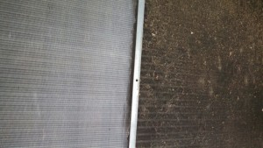
CLEAN YOUR CONDENSOR COILS!!!!

Slide 38



Costs over
$100 per
month!

Slide 39
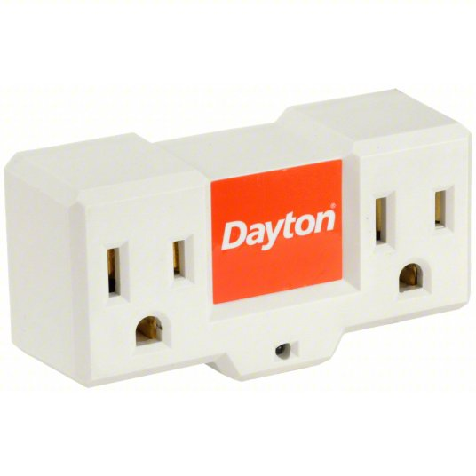
250 WATT
Heat the pipes, not the air! Use of a freeze protection thermostat receptacle and infra-red ”chicken lights” is less expensive than heating the air of an entire room with a space heater and is adequate for freeze protection. This receptacle turns on at 35F and off at 45F.

Slide 40

LED Lighting Advantages
•Low maintenance Costs
•Big driver for outdoor lighting such as street lighting. HID only good for 10,000 –25,000 hours – LED may last up to 60,000 hours
•Energy Efficient
•No mercury and low UV
•Attract less insects
•STURDIER: LEDs are solid express lighting devices that utilize semiconductor material rather than a filament or neon gas. An LED light is a tiny chip exemplified in an epoxy plant enclosure, which makes LEDs far sturdier than traditional incandescent bulbs or neon tubes
•Instant Lighting Brightness and works great in cold
•Typically do not burn out but dim over time
•Focused light: requires no reflectors
•Frequent switching does not harm> Ideal for applications that require frequent on-off cycling
•Possibility of whole new controls strategy
•Works excellent with controls: motion and dimming
•High CRI (Color Rendering Index)

Slide 41
LIGHTING
This lighting is the older magnetic ballast T12 lighting, which is inefficient, can cause headaches and is becoming obsolete.
This high
pressure sodium
(HPS) lighting is
inefficient, very
yellow (poor
color rendition).

Slide 42
The 50 watt “Arc Cob” will offer significant savings and better light than 250 watt high pressure sodium outdoor lights.
LED Tubes are great to replace fluorescent bulbs.

Slide 43
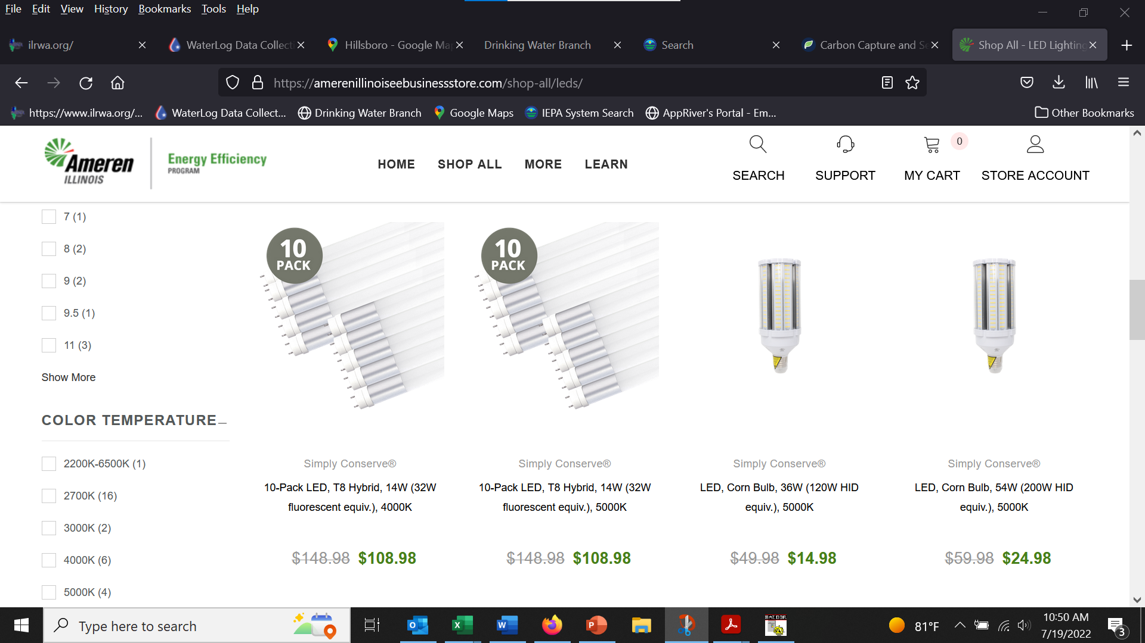

Slide 44
Building
Window/door seals
Sufficient insulation of walls and ceilings of heated/occupied areas
Heated and cooled areas really need to be?
Cracks in building structure that let unconditioned air in or conditioned air out

Slide 45
Easy energy efficient measures to achieve
Replace inefficient motors for more efficient motors.
Install VFD’s on throttled pumps and motors.
Manage hvac and lighting loads.
Install or upgrade scada to monitor and control energy usage.
Based on past NRWA history, 63% of the systems undergoing assessments will implement or develop an action plan to implement some energy efficiency options.

Slide 46

https://amerenillinoissavings.com/
https://amerenillinoissavings.com/business/find-incentives-on-energy-efficient-equipment/
If your rate code in the summary page of your utility bill is DS2, then you can work through the small business program.
https://amerenillinoissavings.com/business/industry-solutions/small-business/
There’s no easier way for eligible small businesses to lower energy costs and boost their bottom line than with the Small Business Direct Install Initiative through Ameren Illinois. You can receive a FREE assessment of your lighting and refrigeration to help identify potential energy-saving improvements throughout your business.
A trained Program Ally Contractor will conduct an on-site assessment of your facility. From there, we will walk you through the results of your assessment and help you choose the upgrades that provide the most benefits and highest amount of energy savings for which many lighting and refrigeration measure incentives may be available. Receive a coupon for a FREE smart thermostat just for having an assessment completed.
Eligible small business facility types may include convenience stores, gas stations, libraries, municipal buildings, nonprofit organizations, places of worship, small offices, schools, restaurants, retail and many more!

Slide 47
Standard VFD Application
Does your facility qualify?
☐Non-residential facility
☐Electric projects: delivery service rate DS2, DS3, DS4, DS5, or DS6 and Energy Efficiency Programs Charge on Ameren Illinois electric bill for the service point corresponding to the electric project. DS1 customers with a farm on the premise may use this application for farm buildings and remote equipment (i.e. equipment that is not within or attached to the residence).
Does your project qualify?
☐Installing new, energy efficient equipment
☐New equipment meets eligibility guidelines as specified in this application
☐Estimated project completion date is by December 31, 2023
VFDs must be functional (installed and ready to operate) by December 31, 2023.
•External labor may be included in the project cost (but not internal labor). Project cost can include upgrade to VFD-compatible motors (if the VFD upgrade causes the motor to be replaced with a new VFD-compatible motor).
$135 per hp (up to 80% of project cost)

Slide 48

Federal & state grants and loans for energy efficiency
https://www.rd.usda.gov/programs-services/programs-services-communities-nonprofits

Slide 49


Slide 50
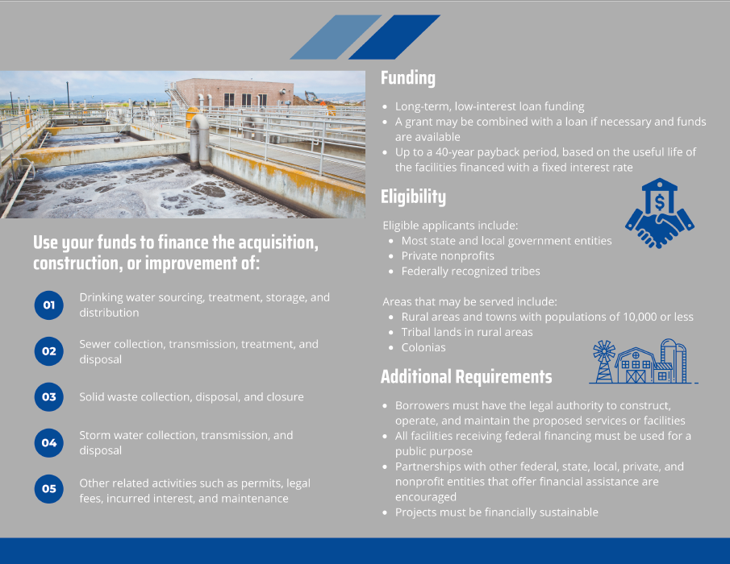

Slide 51
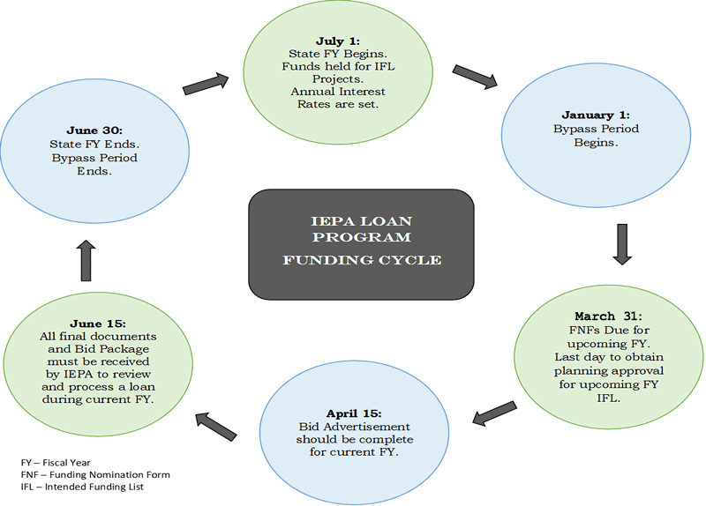
https://www2.illinois.gov/epa/topics/grants-loans/state-revolving-fund/Pages/default.aspx
Please contact the Infrastructure Financial Assistance Section (IFAS) at (217) 782-2027 for additional information.

Slide 52
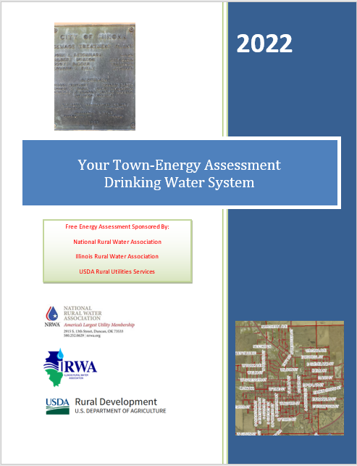

Slide 53
Energy Savings Projects & Payback Years

Slide 54
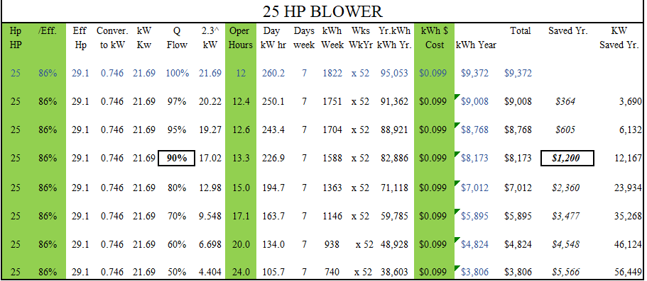

Slide 55
Current Motor vs Premium Eff Motor
Initial Cost Lifecycle Difference at Construction or Replacement
Motor HP | 7.5 |  | Motor HP |  | 7.5
Motor Eff | 85.5% |  | Motor Eff |  | 91.7%
Elec Cost | 0.08 |  | Elec Cost |  | 0.08
Hrs per day usage | 12 |  | Hrs per day usage |  | 12
Cost Per Hr to Run | $ 0.52 |  | Cost Per Hr to Run |  | $ 0.49
Days of Year Run | 365 |  | Days of Year Run |  | 365
kWh per Yr | 28662 |  | kWh per Yr |  | 26724
Cost Per Yr to Run | $ 2,292.97 |  | Cost Per Yr to Run |  | $ 2,137.94
 | Potential Yearly Savings in Elec |  |  |  | $ 155
 | Potential Yearly Savings in kWh |  |  |  | 1938
Current Replacement Cost | $ 1,000.00 |  | Prem Replacment Cost |  | $ 1,350.00
 | Years to Return Extra Cost |  |  |  | 2.3
 | Expected Life of Motor |  |  |  | 20
Total Expected Elec Savings for Lifecycle if Replaced At Initial Construction |  |  |  |  | $ 2,750.63

Slide 56
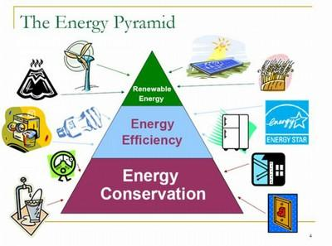

Slide 57
solar
The most common options for Distributed Generation systems are:
buying the system,
leasing the system, or
signing a Power Purchase Agreement (“PPA”).
If you lease or sign a PPA, you don’t own the system, but you still get many of the benefits.

Slide 58
NET METERING
PV (photovoltaic) electricity created by the solar installation is fed into the grid and offset with electricity provided by the utility through the Net Metering rules:
❑Systems are designed to offset 90-95% of historical usage to ensure that the production will be used by the host in a year. The additional 5-10% allows headroom for any host efficiency upgrades as well
❑There is no new risk of power outages or power quality as the solar power plant is integrated with the grid
❑Credits must be used on an annual basis, not within a given month or day. This allows sizing the system to the full yearly kWh usage
Will be though a new “In and Out” meter installed by the utility when the solar is ready to be turned on. Credits will be built up for the benefit of the customer on a monthly basis through Net metering guidelines.

Slide 59
determine if your site is a good candidate for solar:
❑Utility bills for the prior year
❑Wetlands and flood plains (Abide by codes and regulations)
❑Setbacks and local regulations (Size of solar that can be built on your site if allowed)
❑Shading and output analysis (Open space suitable for solar, define annual solar resource)
❑Adequate acreage (acreage depends on size of plant)
❑Utility rates (higher utility rates offer more savings with solar)
❑Usage (solar will offset >90% of plant usage. Too small or too big usage is not ideal)
❑Savings analysis (yearly and life of agreement expected savings against historical utility rates)

Slide 60
l.o.i.
The solar company will require the Host to sign a L.O.I. (Letter Of Intent). This states that the Host intends to negotiate with the Solar company concerning installation but cannot have any negotiations with another solar provider for the next six months.

Slide 61
P.P.A.
Solar built by and paid for by the solar company for the site through a P.P.A. (Power Purchase Agreement) with buy-out options after 10, 15, 20, 25 or 30 years thereafter.
There is no upfront investment, just commitment to make monthly payments for electricity generated by the solar facility at rates that are lower than the utility rates over a 30 year period at a fixed price. Allows the Host to purchase power at a reduced cost
Does not involve any up-front cost from host
Solar company build and manage the system over its lifetime –no Host operational responsibilities
Host only pays for power produced
The savings on the energy created are negotiated with the solar company and are included in the PPA!!

Slide 62
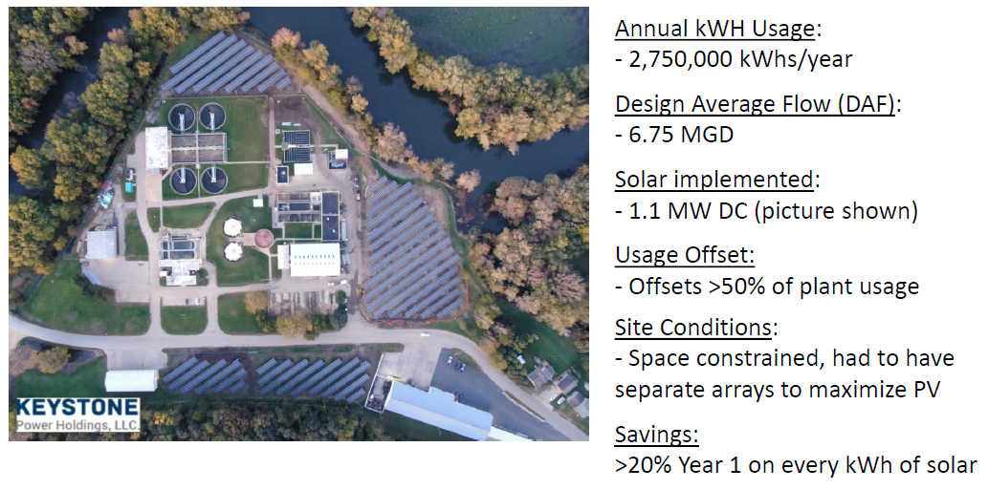

Slide 63
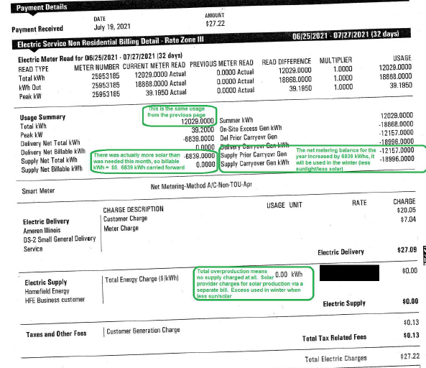

Slide 64
The Lifetime of Solar Panels
How long do solar panels last? A question that most people have in mind when considering solar panels. According to studies, the life expectancy of solar panels is about 30 years before decommissioning.
During the life of photovoltaic panels, a 20 per cent decrease in power capacity might occur. Between the first 10 to 12 years, the maximum decrease in efficiency is 10 per cent, and 20 per cent when reaching 25 years. These figures are guaranteed by the majority of manufacturers.
Recent experience shows that in reality, the efficiency drops by merely 10 per cent after 25 years. The lifespan of solar panels may thus be much longer than officially stated. The lifespan of high quality PV panels may even reach 30 to 40 years, and be still functional afterwards, though with decreasing efficacy.

Slide 65
END OF TERM
After the PPA term you will have the option to
Require removal at their cost,
To renew a negotiated agreement,
Or to buyout. If the system is bought out, all energy created by the solar installation is free after buyout.

Slide 66



Water you thinking?

Slide 67
Illinois Rural Water Association
David Speagle
Energy Efficiency Technician
217-820-1560
speagle@ilrwa.org

